Slide 1
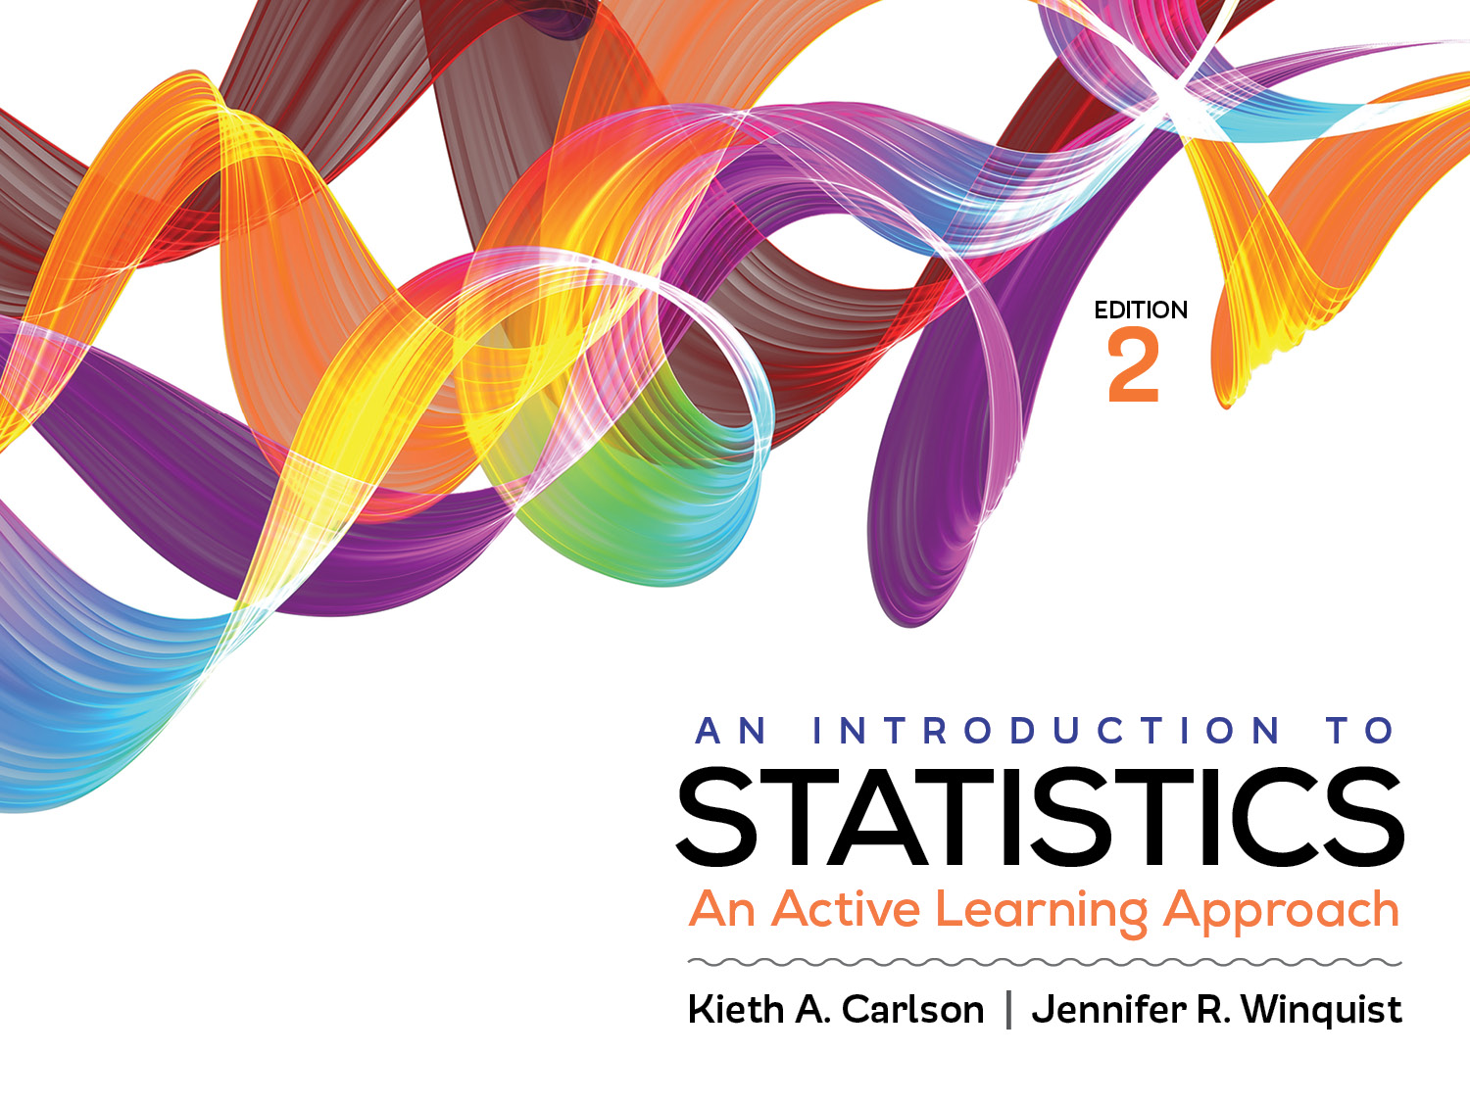
Introduction to Activity 12.3
Two-factor ANOVA III

Slide 2
Activity 12.3 will require you to:
Identify the IVs, their levels, and the DV
Generate SPSS output for two-factor ANOVA and interpret it
Create graphs for main effects and interactions
Summarize the results of a two-way ANOVA

Slide 3
Example
Do the most effective studying strategies depend on one’s gender? Dr. Reminder had a group of males study by self-testing or by re-reading chapters. Additionally, a group of females also studied by self-testing or by rereading chapters. One week later, everyone took an exam over the same material.
Identify the IV(s) and levels.
Identify the DV
Why is a 2-factor ANOVA the correct test in this situation?
How many significance tests that this study will produce? Name them.
Notes:
IVs = Studying method (self-testing or re-reading) ; Gender (male or female)
DV = score on an exam
There are 2 categorical IVs and an interval/ratio DV
3; main effect of studying method, main effect of gender; interaction between studying method and gender

